Slide 1

2019-20 Digital experience insights surveys launch - what is new this year and how to get started
https://digitalinsights.jisc.ac.uk

Slide 2
Agenda
  About the insights service – (Ruth) – 15 minutes
          Introduction to the team
          Why do we need to collect data?
          What does the service do?
          Open/close dates for the surveys
  What is new in 2019-20 surveys (Helen) – 20 minutes
          Principles for question (re)design and update
          What’s new?
          Key metrics
          Putting it all together – new guidance and mapping
          New guidance slides available
  Questions raised in the chat window – (Mark) – 10 minutes
  Follow developments (Ruth) – 5 minutes

Slide 3
About the insights service
What is new in 2019-20 surveys
Questions raised in chat window
Follow developments

Slide 4

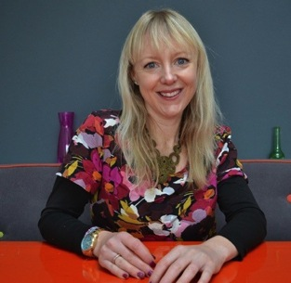




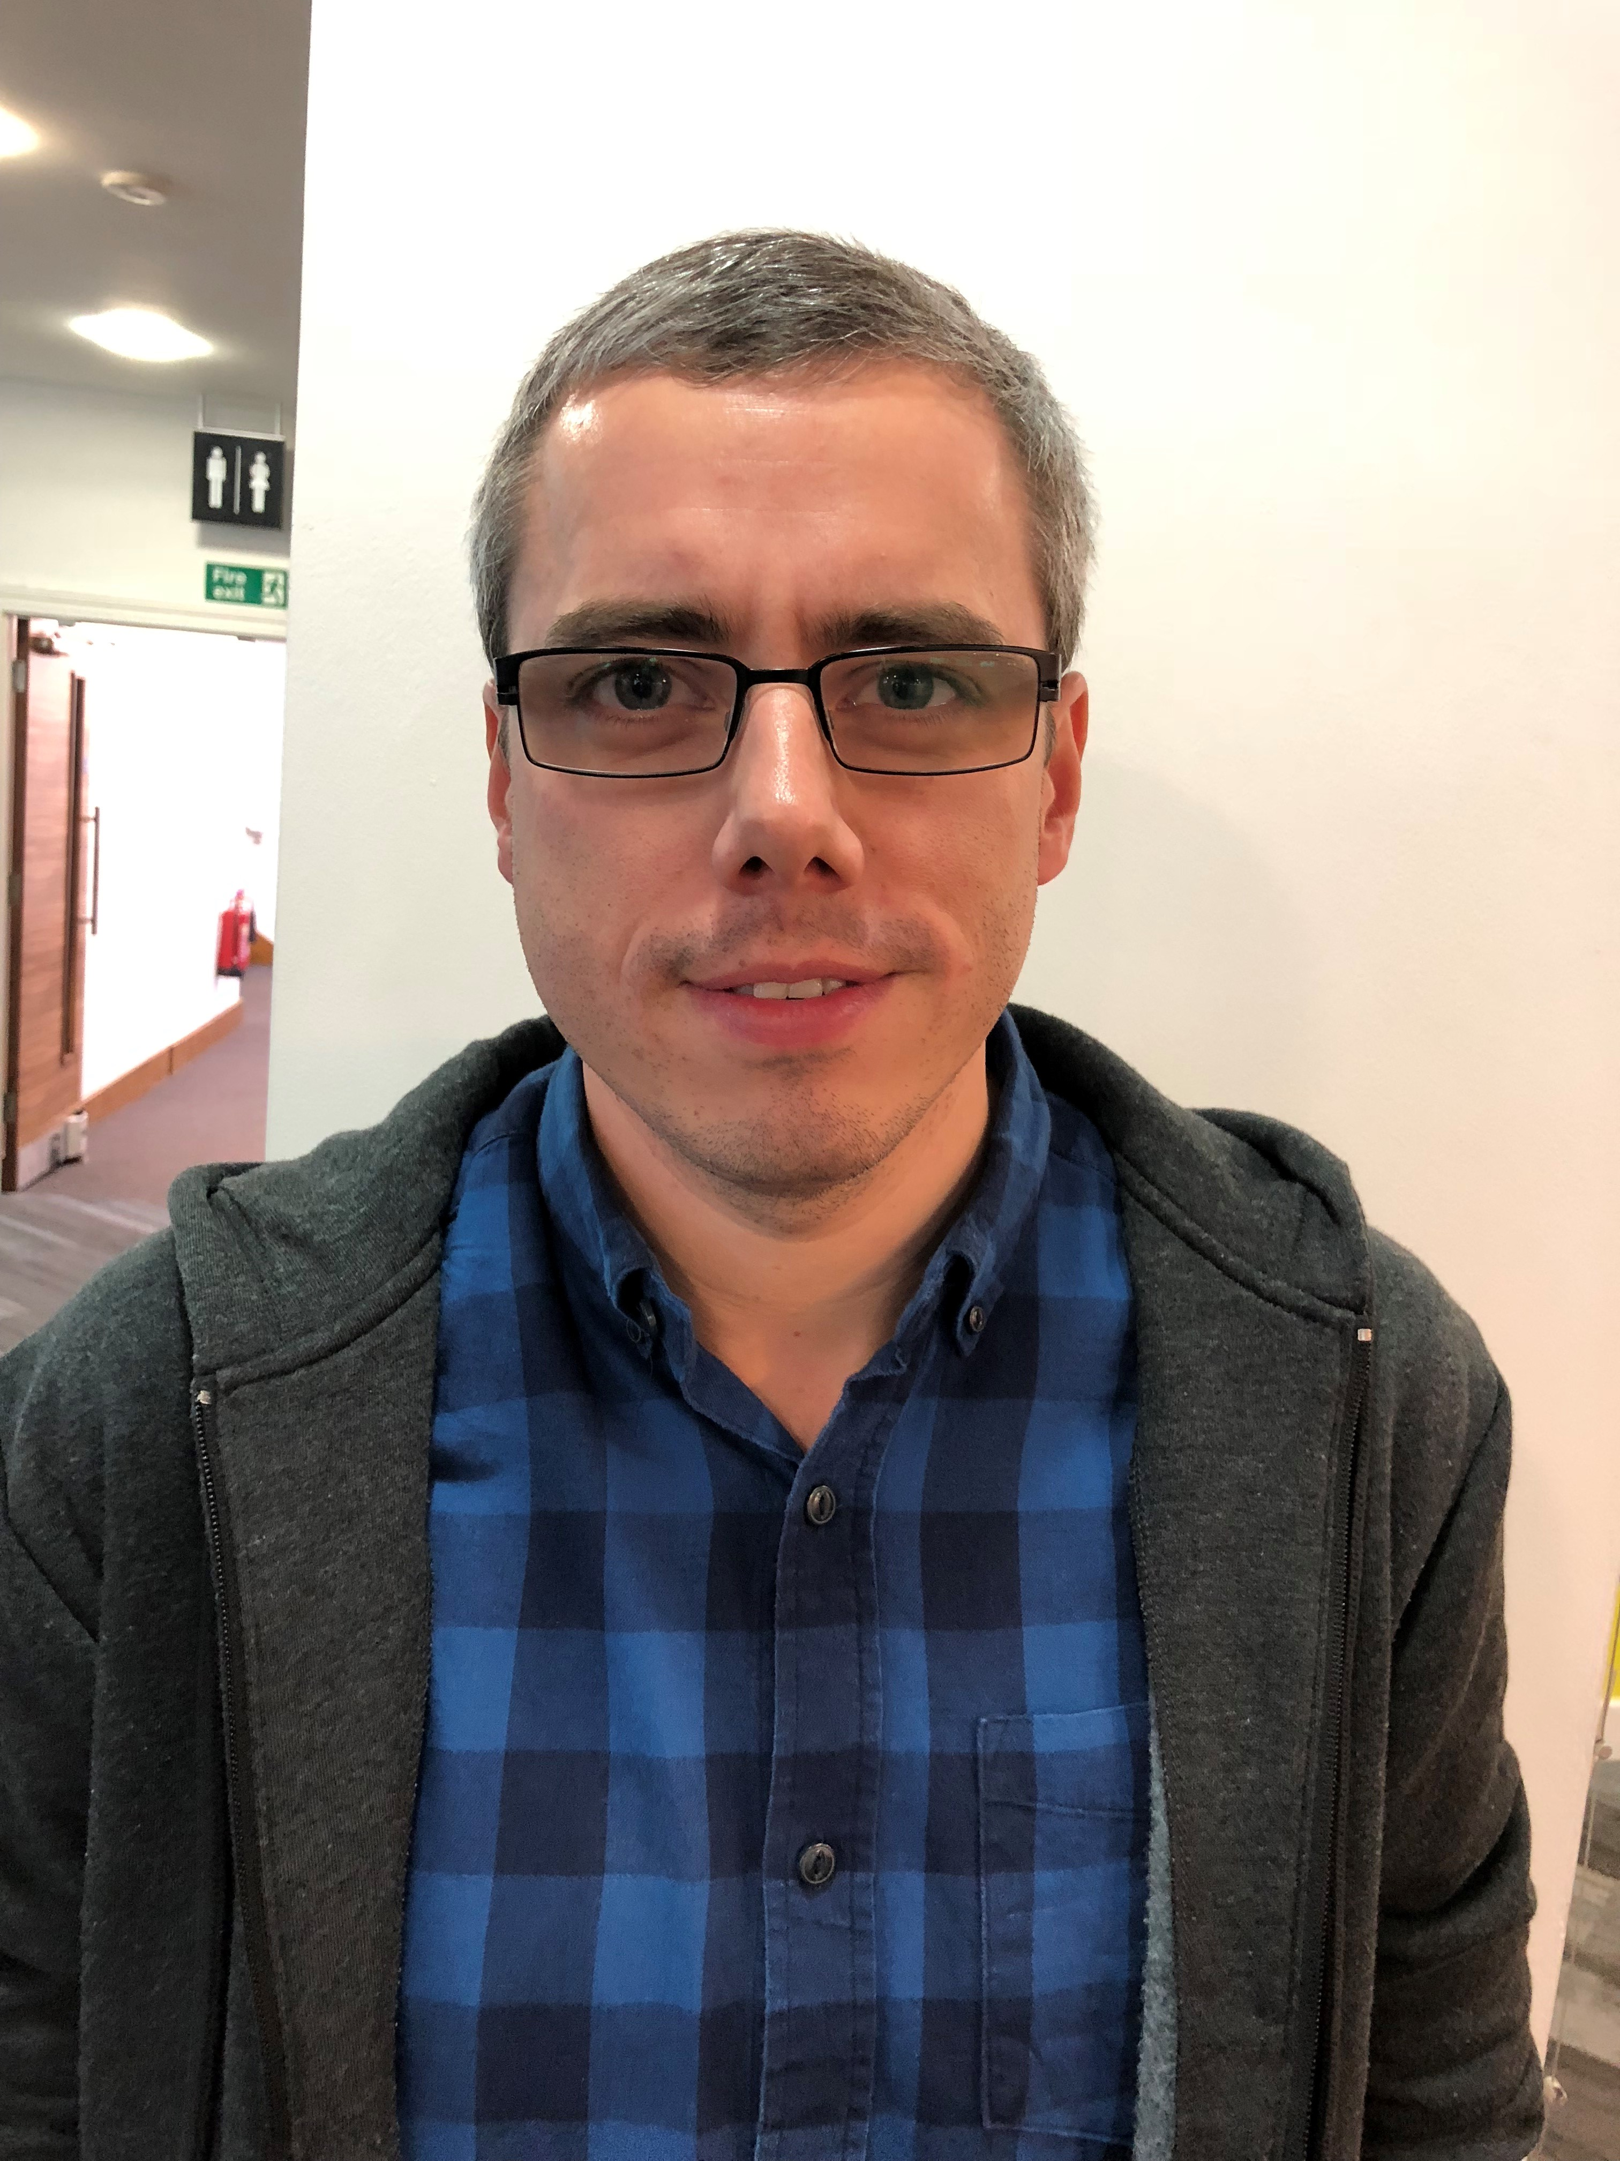
Who are we?
Helen Beetham - consultant
Tabetha Newman - consultant
Mark Langer-Crame – senior analyst, Jisc
Sarah Knight – service owner, Jisc
Clare Killen – content manager, Jisc
Ruth Drysdale – service manager, Jisc
Darren Colquhoun – client support officer, Jisc

Slide 5
Why do we need to collect data about staff and students’ use of technology?
Office for Students predicts that over a million digitally skilled people will be needed by 2022
Recognition within the government’s edtech strategy, Realising the potential of technology in education, that ‘technology is increasingly part of our society’
Each FE colleges spends approximately £1 million pounds a year on their ICT infrastructure and 3.8 % of universities annual budget is allocated to supporting the digital environment
So we need evidence to support:
  Identification of the digital skills gap
  Return on investment
  That students and staff are getting the full benefits of the investment in the digital environment at their institutions
  Impact of the implementation of institutional digital strategy
  Benchmark against other universities and colleges

Slide 6
What does the service do?
Our digital experience insights surveys provide powerful data on how your students and staff are using the technology on offer
Colleges and universities can use this evidence to inform digital strategies and operational decisions about the digital environment
‘The overall impact of running the insights service for our institution is significant. The service has given us a source of evidence which we have used to build business cases, secure investment and lead transformation - safe in the knowledge that transformation is being led by the student voice and the student expectation.’
Richard Aird, head of customer service, information services, The University of Stirling

Slide 7
Our digital experience insights surveys are now open
They will close on;
1 May UK student survey
18 May UK student benchmarking groups available
1 June UK professional services staff survey
3 July UK teaching staff surveys
20 July UK teaching staff and professional services staff benchmarking groups . …………….available
https://digitalinsights.jisc.ac.uk/our-service/key-dates-for-2019-2020

Slide 8
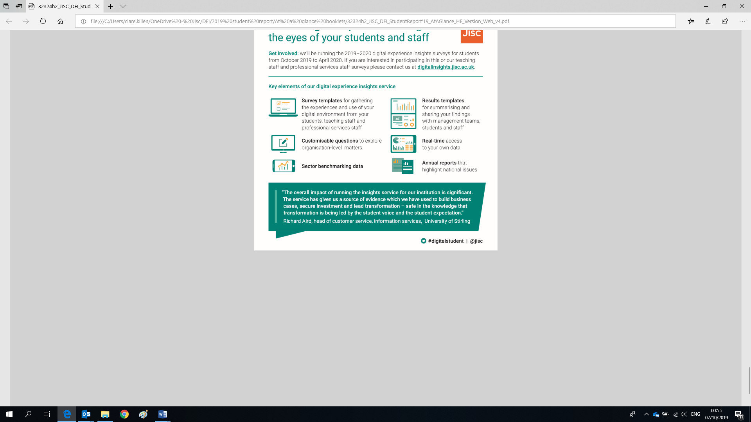
‘The survey has been helpful in bringing together technology-enhanced learning and IT perspectives. The data and student concerns about infrastructure issues have helped everyone to see the need for a cohesive approach if we are to fulfil our digital ambitions’
Marc Griffith, head of digitally enhanced learning, London South Bank University

Slide 9








Institutional insights project
4. Enhance student
digital experience
Senior Champion
Project team
Working group
Stakeholders: SU , IT, library, academics
1. Plan
Feedback to respondents on changes
Change initiated
Governance
Enhance services
Communication plan
Budget
Digital Experience Insights
Student
Teaching staff
Professional service staff
Sampling cohort
Report to SE
Governance
groups
Prizes?
Surveys start
& end dates
Recommendations
Design local
questions
Link to other SE
Datasets NSS, modular feedback
Survey set up
in BOS
Benchmark
3. Analyse
2. Survey
Quantitative and Qualitative analysis
Launch surveys
BOS or export
Into Excel/
SPSS/NVIVO
Monitor responses

Slide 10
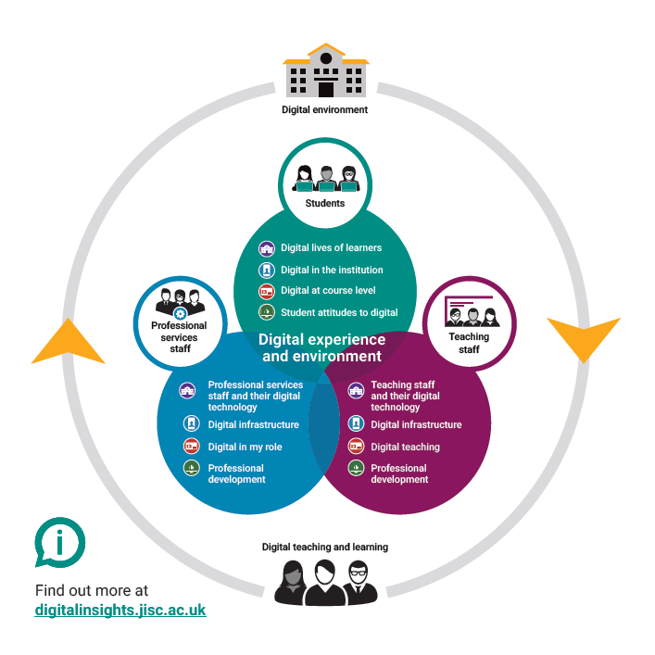
Digital experience insights surveys
Our insights surveys provide powerful data on how your students and staff are using technology in learning and teaching
Designed to help you to understand and improve the digital experience you offer
Address the challenges you face - we have worked with 100+ organisations and 100,000+ students to pilot and refine our surveys
With you at every step – responsive support to implement the survey, analyse your data and respond to its findings
An active community of practice with regular online and face-to-face events

Slide 11
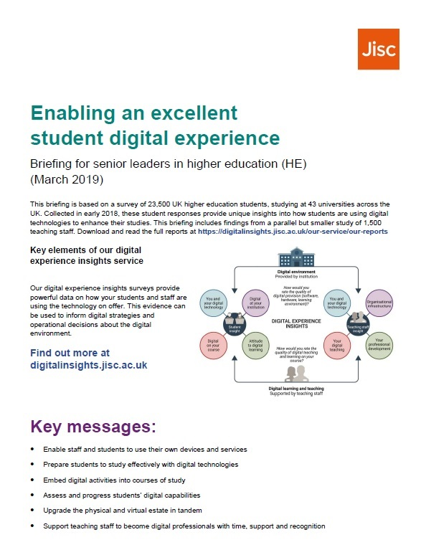
Resources to support an excellent digital experience
Available from http://bit.ly/insightsreports
Jisc NUS roadmap for supporting students to improve their digital experience at university and college
Enabling an excellent digital experience guidance for engaging senior leaders and informing digital (FE and HE versions)
Exploring the student digital experience: student, staff and organisational factors
Using persona analysis to compare student social behaviours with institutional digital provision: a pilot study

Slide 12
About the insights service
What is new in 2019-20 surveys
Questions raised in chat window
Follow developments

Slide 13
Questions launch 2019-20
Principles for question (re)design and update
What’s new?
Key metrics
Putting it all together – new guidance and mapping
New guidance slides available

Slide 14

Principles for question (re)design and updating
Many organisations like to track data year-on-year
However, annual updates are welcomed if they: improve end-user experience; allow easier analysis; address new and emerging issues
We make changes based on:
Feedback on last year's surveys, especially from our expert panels
Performance of questions, including new questions introduced in pilots (this year, professional staff survey pilot)
Issues identified in the qualitative feedback or arising from Jisc's work more generally
Other research and analysis (e.g. student personas)

Slide 15
What’s new for 2019-20?
New professional staff survey (researcher survey in pilot)
Some questions in some surveys have moved quadrants to allow for more consistent mapping
KPI questions for each quadrant, not just the two key ratings
Quadrant 1: new attitudinal questions based on persona work; new question about working/studying in other organisations
Quadrant 2: more detailed questions about the learning environment; organisations add their local name or platform
Quadrant 3: updates to learning and teaching activities
Quadrant 4: more detailed questions about digital skills development; new question about when users discuss their digital skills

Slide 16
Key metrics
Quadrant 1:
    Overall, how confident are you at trying out new technologies?
Quadrant 2:
    Overall, how would you rate the quality of your organisation's digital provision (software, hardware, learning environment)
Quadrant 3:
    Overall, how motivated are you to use technology to support your teaching?
    Overall, how would you rate the quality of digital teaching and learning at your organisation?
Quadrant 4:
    Overall, how would you rate the quality of support you get from your organisation to develop your digital skills?

Slide 17
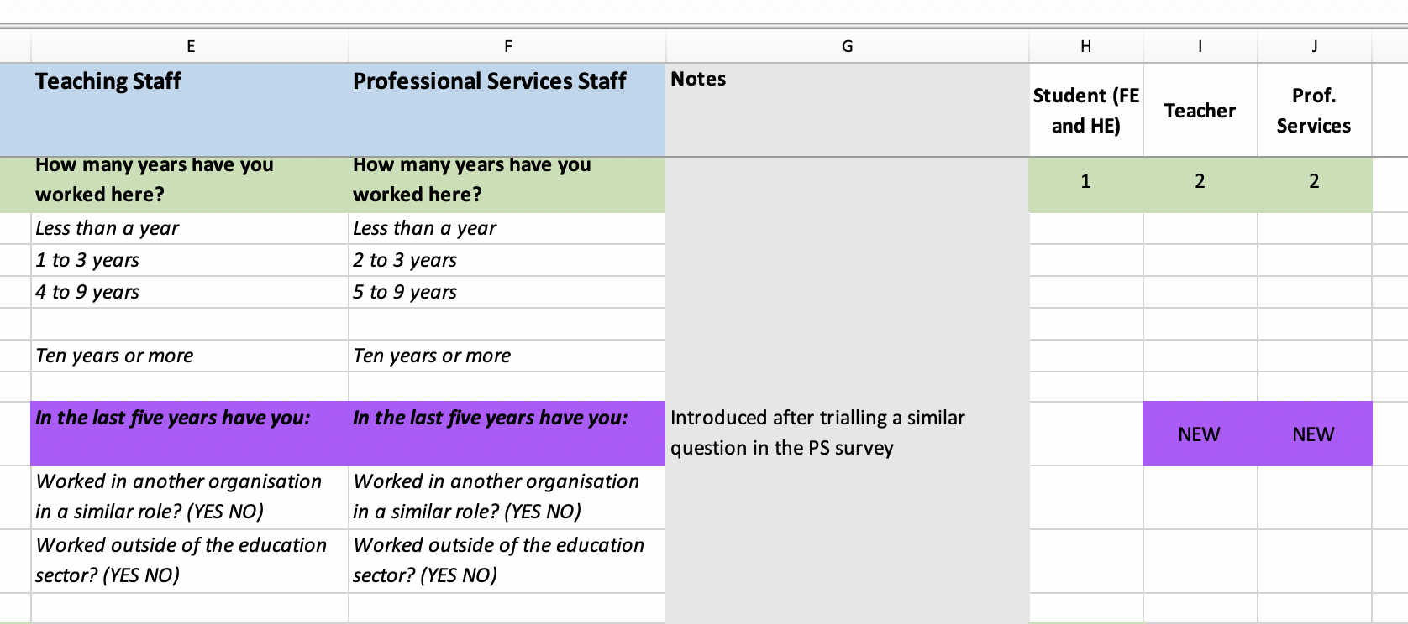
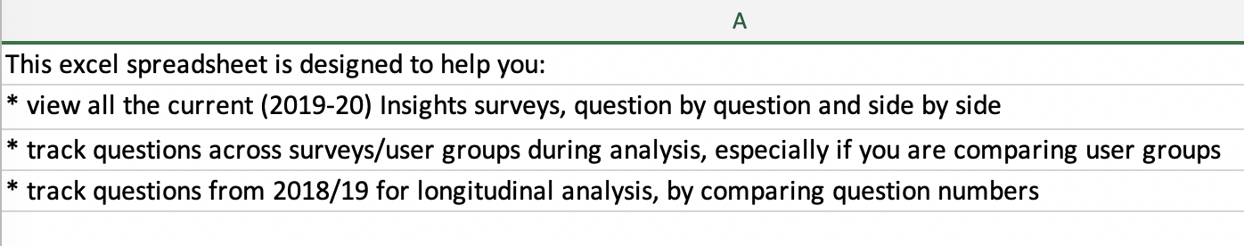
Putting it all together
Single mapping document in excel
New guidance materials online
360 degree insights as ppt slides

Slide 18
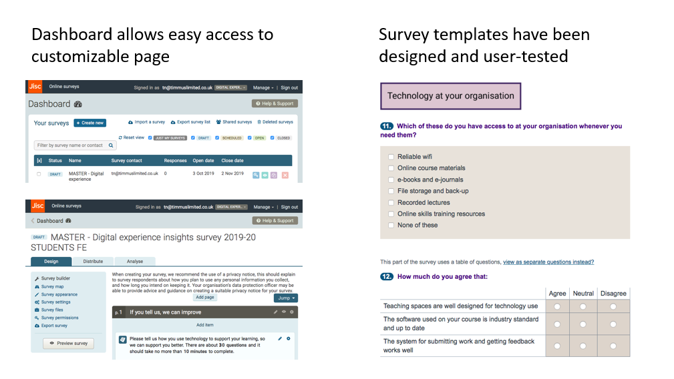
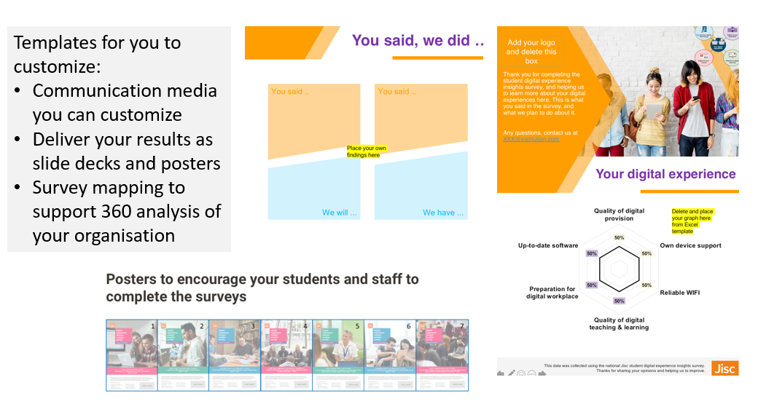
New guidance slides available

Slide 19
About the insights service
What is new in 2019-20 surveys
Questions raised in chat window
Follow developments

Slide 20
About the insights service
What is new in 2019-20 surveys
Questions raised in chat window
Follow developments

Slide 21
Follow developments
Digital experience insights https://digitalinsights.jisc.ac.uk
  Case studies on institutional use: bit.ly/insightscase
  Researcher and TNE pilots
  Join the insights community of practice events: bit.ly/insights_cop
      6th Nov 2019 Staffordshire University (now fully booked)
      21st May 2020 University of Northampton (bookings to open soon)
      Join the Jiscmail community of practice list: bit.ly/jiscmail_cop

Slide 22

Get in touch…
Digital experience insights
help@jisc.ac.uk (putting ‘digital experience insights’ in subject title)
Ruth Drysdale
Ruth.Drysdale@jisc.ac.uk
https://digitalinsights.jisc.ac.uk
#digitalstudent
Except where otherwise noted, this work is licensed under CC-BY

