Slide 1
Digital experience insights survey: findings from teaching staff survey conducted [dates] at [name of college or university]​
April 2022

Slide 2
Instructions for using this template (delete this slide)
This template has been designed to help you to present your data and analysis from the Jisc teaching staff digital experience insights survey. It focuses on the data that we feel is most relevant to share with stakeholders in your organisation. Remember to delete any instructions once you have created your own version
Use our guidance on using insights surveys in Jisc online surveys to support you (section: Accessing the data collected during and after the survey is live)
The charts are embedded within this presentation and can be edited by right clicking on the chart and then selecting “edit data/edit data in Excel”. Note only the cells highlighted blue need to be filled in
For the qualitative/free text questions (ie slide 14) you will need to use the accompanying Excel spreadsheet for the teaching staff survey to create the information you will need. This can be downloaded from our website
Slide 10 includes demographical information which you will need to get from your own survey analysis
If you ran our other surveys (eg student, professional services staff and researchers), we encourage you to compare and contrast the teaching staff survey results with the findings from these. There is a separate Excel spreadsheet and PowerPoint slide set to help you to build charts that compare across different surveys
Text highlighted indicates where you need to insert your own data
If you experience any problems with using this template or the supporting Excel file, please contact: help@jisc.ac.uk, putting 'digital experience insights' in the subject line
Remember to check your presentation for accessibility once complete (review / check accessibility)

Slide 3
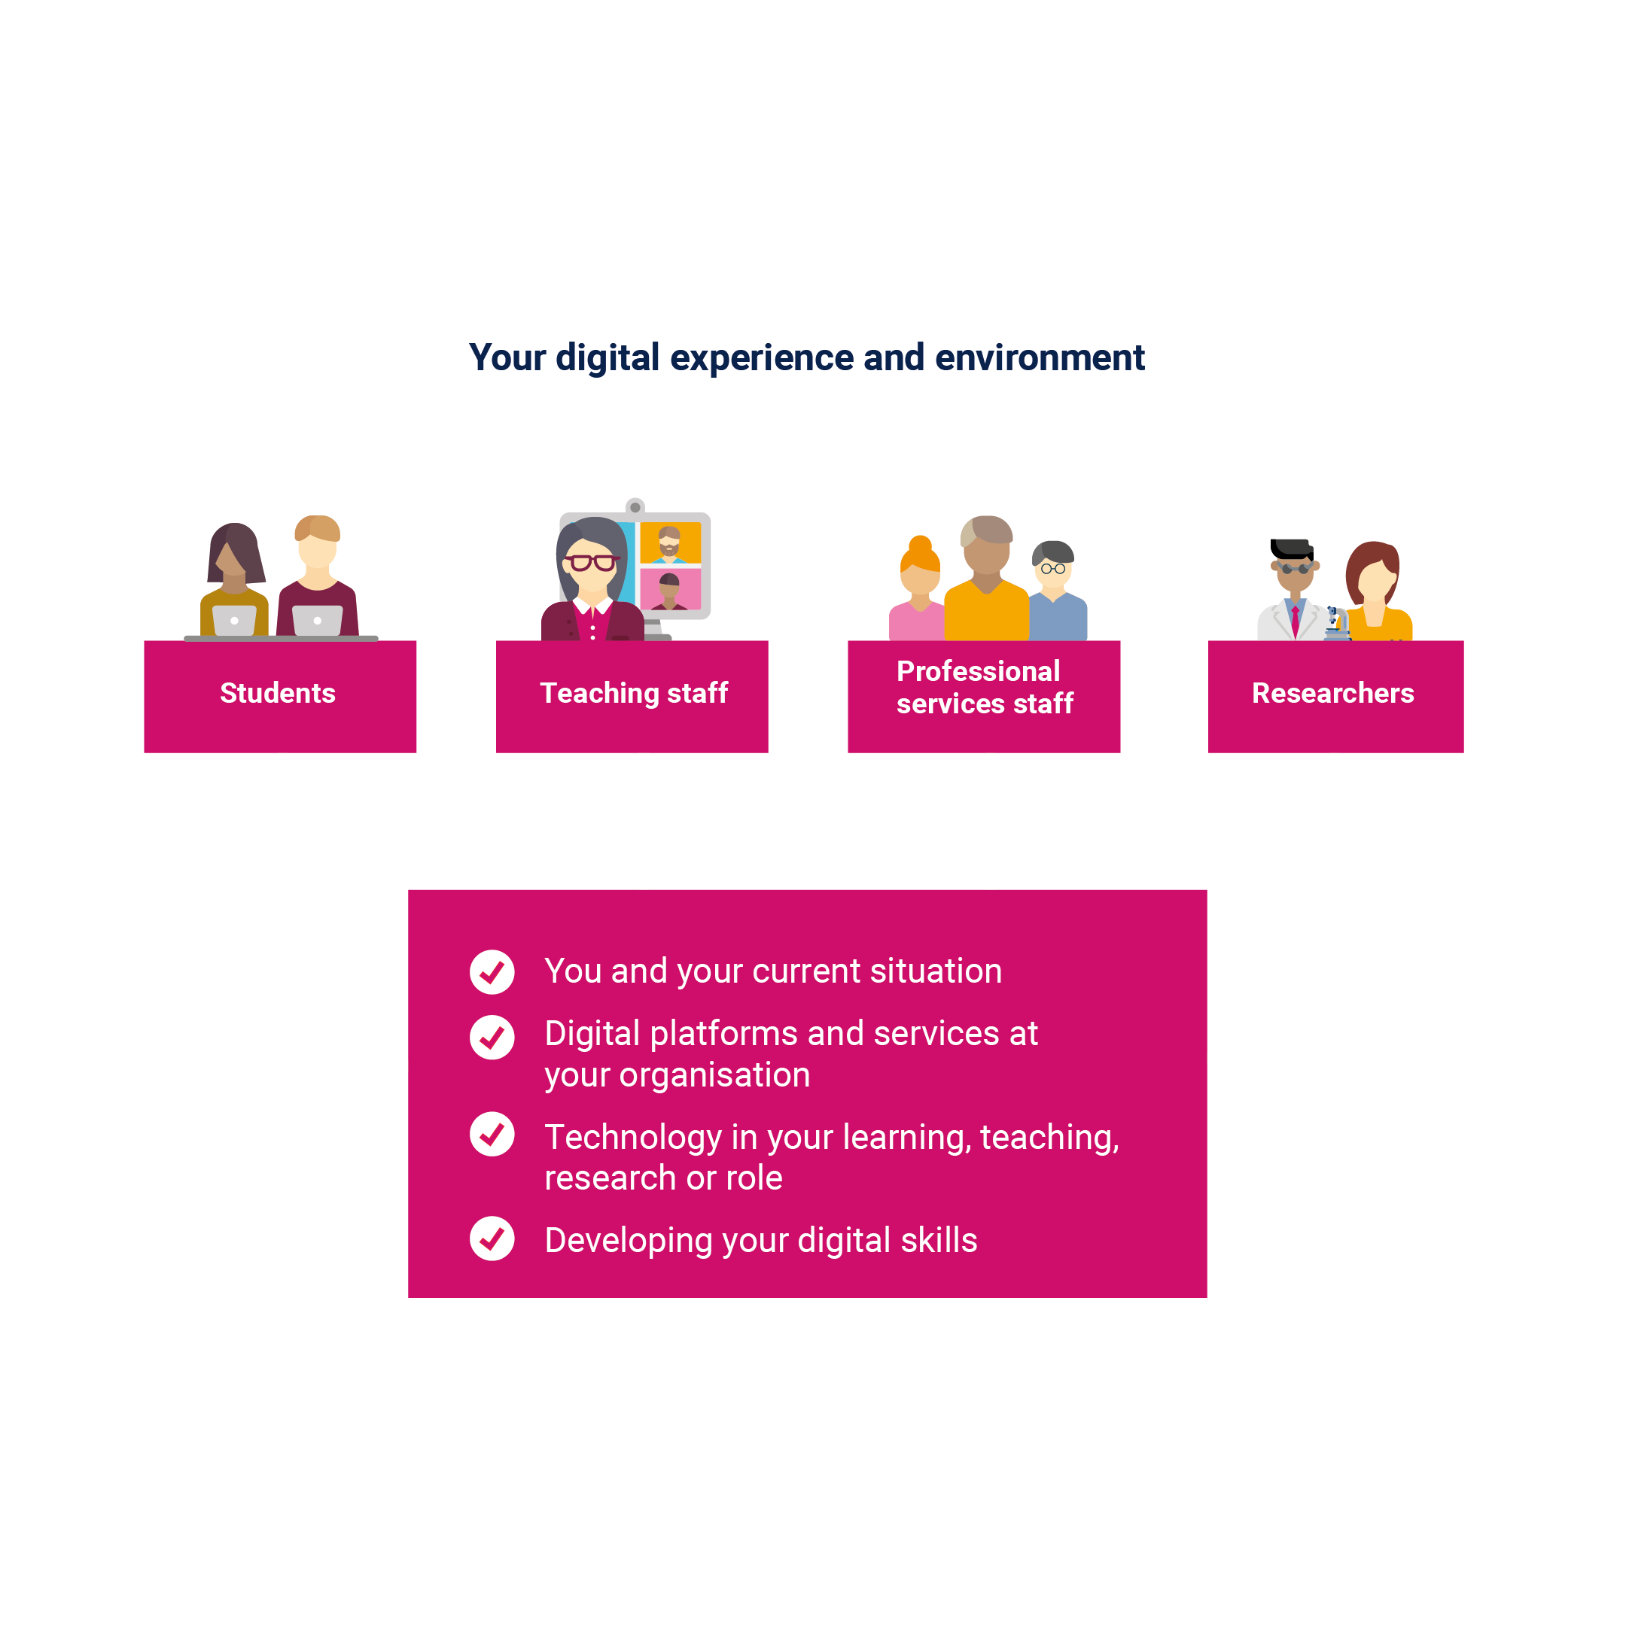
What is the teaching staff digital experience insights survey?
Asks teaching staff across further education (FE) and higher education (HE) about their experiences of using technology at their college or university
Run by Jisc
Separate surveys for FE and HE
For 2020/21 there were over 6,500 responses from UK FE and HE teaching staff
This presentation summarises some key findings from data collected from our teaching staff

Slide 4
Summary of key metrics
Right click on chart and select: ‘edit data/edit data in Excel'
Technology at your organisation
XX% agreed they were supported to use their own devices (Q8a)
XX% agreed we supported them to access online platforms/services off site (Q8b)
XX% rated the quality of the online teaching environment as good or above (Q10)
Technology in your teaching
XX% agreed that teaching online was convenient (Q17a)
Developing your digital skills
XX% agreed we provided them with reward and recognition for their digital skills (Q21d)
XX% rated the support we offered them to teach effectively online as good or above (Q24)

Slide 5
Benchmarking with other UK organisations

Slide 6
Benchmark comparisons
The digital experience insights surveys national dataset allows us to compare our results with anonymised overall results from other UK organisations that ran the teaching staff insights survey (see table below). Section 4 of our guide to using insights surveys in Jisc online surveys provides information on how to view, download, analyse and benchmark your data.
We have compared the six key metrics shown earlier in this presentation on slide 4.
Add any insight or comments relevant to your data in comparison with the UK data.
Question | Our data | UK data
Supported to use own devices (Q8a) | XX% | XX%
Support access to online platforms/services off site (Q8b) | XX% | XX%
Quality of the online teaching environment (Q10) | XX% | XX%
Online teaching was convenient (Q17a) | XX% | XX%
Provided reward/recognition for digital skills (Q21d) | XX% | XX%
Supported to teach effectively online (Q24) | XX% | XX%

Slide 7
Findings by theme

Slide 8
Our teaching staff sample
We asked XXX teaching staff (in XXX departments, XXX campus)
They were sent the link by (which marketing methods did you use to reach out to your staff? Did you advertise one link to the survey, or did you email them unique links to the survey?)
XXX number of our teaching staff responded to the insights survey (% response rate)
The following slides summarise data from key questions in the four areas of the insights question set
Whenever teaching staff were asked how much they agreed with a statement they could answer either agree, neutral, or disagree

Slide 9
Theme one (T1)
You and your technology

Slide 10
Our survey sample
Percentage breakdown of teaching staff that responded to the survey versus all your teaching staff in your organisation, by gender (Q2).
Does the DEI survey look representative of your total teaching staff?
Where relevant, you can copy and paste table above to create other breakdowns by ethnicity (Q3), number of years taught at organisation (Q1) and/or identified as being disabled or not (Q4).
 | DEI survey | All teaching staff at our organisation
Female | XX% | XX%
Male | XX% | XX%
Other eg non-binary | XX% | XX%

Slide 11
T1: Devices used regularly for teaching
Right click on chart and select: ‘edit data/edit data in Excel'
(Q5). Teaching staff were asked, which of these devices they regularly used for teaching? (they could tick all that applied).

Slide 12
Theme two (T2)
Technology at your organisation

Slide 13
T2: Digital platforms and services at your organisation
(Q8a). XX% agreed we supported them to use their own devices
(Q8b). XX% agreed we supported them to access online platforms and services off site
(Q8c). XX% agreed we communicated effectively online, eg messaging, notifications
(Q8d). XX% agreed we gave them the chance to be involved in decisions about teaching platforms

Slide 14
T2: Digital tool or app really useful for teaching
(Q9). Teaching staff were asked to give an example of a digital tool or app they found really useful for teaching.
This was a free text question which we analysed for themes.
Common themes included:
XX% of teaching staff that commented mentioned this…
XX% of teaching staff that commented mentioned this…
[Download your free text data via Jisc online surveys ‘analyse’ area, open in Word or Excel, read the feedback and try to group into themes (see accompanying Excel sheet to carry out grouping here). Also, the guide to analysing your qualitative data can be found here.]

Slide 15
T2: Overall quality of the online teaching environment
Right click on chart and select: ‘edit data/edit data in Excel'
(Q10). Teaching staff were asked to provide an overall rating for the quality of the online teaching environment. XX% rated us as good or above.
[Add any insights from the data here]

Slide 16
T2: Prefer us to invest in
Right click on chart and select: ‘edit data/edit data in Excel'
(Q11). Teaching staff were asked what they would prefer us to invest in.
[Add any insights from the data here]

Slide 17
Theme three (T3)
Technology in your teaching

Slide 18
T3: Difficulties when teaching online
Right click on chart and select: ‘edit data/edit data in Excel'
(Q14). Teaching staff were asked if any of these had made it difficult for them to teach online (they could tick all that applied).

Slide 19
T3: Teaching activities carried out
Right click on chart and select: ‘edit data/edit data in Excel'
(Q16).Teaching staff were asked, in the last two weeks, which teaching activities they had done.
[Add any insights from your data here]

Slide 20
T3: Teaching online
Right click on chart and select: ‘edit data/edit data in Excel'
(Q17). Teaching staff were asked how much they agreed with four statements about teaching online.
[Add any insights from your data here]

Slide 21
T3: Positive aspects of online teaching
(Q18). Teaching staff were asked, what aspect of teaching online, if any, had been most positive for them.
This was a free text question, which we analysed for themes.
Common themes included:
XX% of teaching staff that commented mentioned this..
XX% of teaching staff that commented mentioned this…
[Download your free text data via Jisc online surveys ‘analyse’ area, open in Word or Excel, read the feedback and try to group into themes (see accompanying Excel sheet to carry out grouping here). Also, the guide to analysing your qualitative data can be found here

Slide 22
T3: Negative aspects of online teaching
(Q19). Teaching staff were asked, what aspect of teaching online, if any, had been most negative for them.
This was a free text question, which we analysed for themes.
Common themes included:
XX% of teaching staff that commented mentioned this...
XX% of teaching staff that commented mentioned this…
[Download your free text data via Jisc online surveys ‘analyse’ area, open in Word or Excel, read the feedback and try to group into themes (see accompanying Excel sheet to carry out grouping here). Also, the guide to analysing your qualitative data can be found here

Slide 23
Theme four (T4)
Developing your digital skills

Slide 24
T4: Support and guidance for digital skills development
Right click on chart and select: ‘edit data/edit data in Excel'
(Q21). Teaching staff were asked four questions about the support and guidance they received for digital skills development.
[Add any insights from the data here]

Slide 25
T4: Where did teaching staff go for help with online and digital skills?
Right click on chart and select: ‘edit data/edit data in Excel'
(Q22).
[Add any insights from the data here]

Slide 26
T4: Which skills have we provided support and training for?
Right click on chart and select: ‘edit data/edit data in Excel'
(Q23).
[Add any insights from the data here]

Slide 27
T4: Support to help teaching staff teach effectively online
Right click on chart and select: ‘edit data/edit data in Excel'
(Q24). Teaching staff were asked to provide a rating for how well they feel we supported them to teach effectively online. XX% rated us as good or above.
Add any comments based on findings from your data

Slide 28
T4: Teaching effectively online
(Q25). What one thing should we do to help you to teach effectively online?
This was a free text question, which we analysed for themes.
Common themes included:
XX% of teaching staff that commented mentioned this...
XX% of teaching staff that commented mentioned this…
[Download your free text data via Jisc online surveys ‘analyse’ area, open in Word or Excel, read the feedback and try to group into themes (see accompanying Excel sheet to carry out grouping here). Also, the guide to analysing your qualitative data can be found here

Slide 29
What next?
Some further things to consider include:
Do you have any insights survey data from other surveys to compare with the teaching staff data?
Who will you communicate these findings to?
How will you feed back results to teaching staff across your organisation?
How do you plan to work in partnership with teaching staff to take forward actions resulting from the data?

Slide 30
Suggested next steps…
[Add any recommendations for your organisation]

