Slide 1
Digital experience insights survey: findings from researcher's survey conducted [dates] at [name of college or university]​
November 2022

Slide 2
Instructions for using this template (delete this slide)
This template has been designed to help you to present your data and analysis from the Jisc researchers digital experience insights survey. It focuses on the data that we feel is most relevant to share with stakeholders in your organisation. Remember to delete any instructions once you have created your own version
Use our guidance on using insights surveys in Jisc online surveys to support you (section: Accessing the data collected during and after the survey is live)
The charts are embedded within this presentation and can be edited by right clicking on the chart and then selecting “edit data/edit data in Excel”. Note only the cells highlighted blue need to be filled in
For the qualitative/free text questions (ie slide 16) you will need to use the accompanying Excel spreadsheet for the researcher's survey to create the information you will need. This can be downloaded from our website
Slide 10 includes demographical information which you will need to get from your own survey analysis
If you ran our other surveys (eg student/learners, teaching or professional services staff), we encourage you to compare and contrast the researchers survey results with the findings from these. There is a separate Excel spreadsheet and PowerPoint slide set to help you to build charts that compare across different surveys
Text highlighted indicates where you need to insert your own data
If you experience any problems with using this template or the supporting Excel file, please contact: help@jisc.ac.uk, putting 'digital experience insights' in the subject line
Remember to check your presentation for accessibility once complete (review / check accessibility)

Slide 3
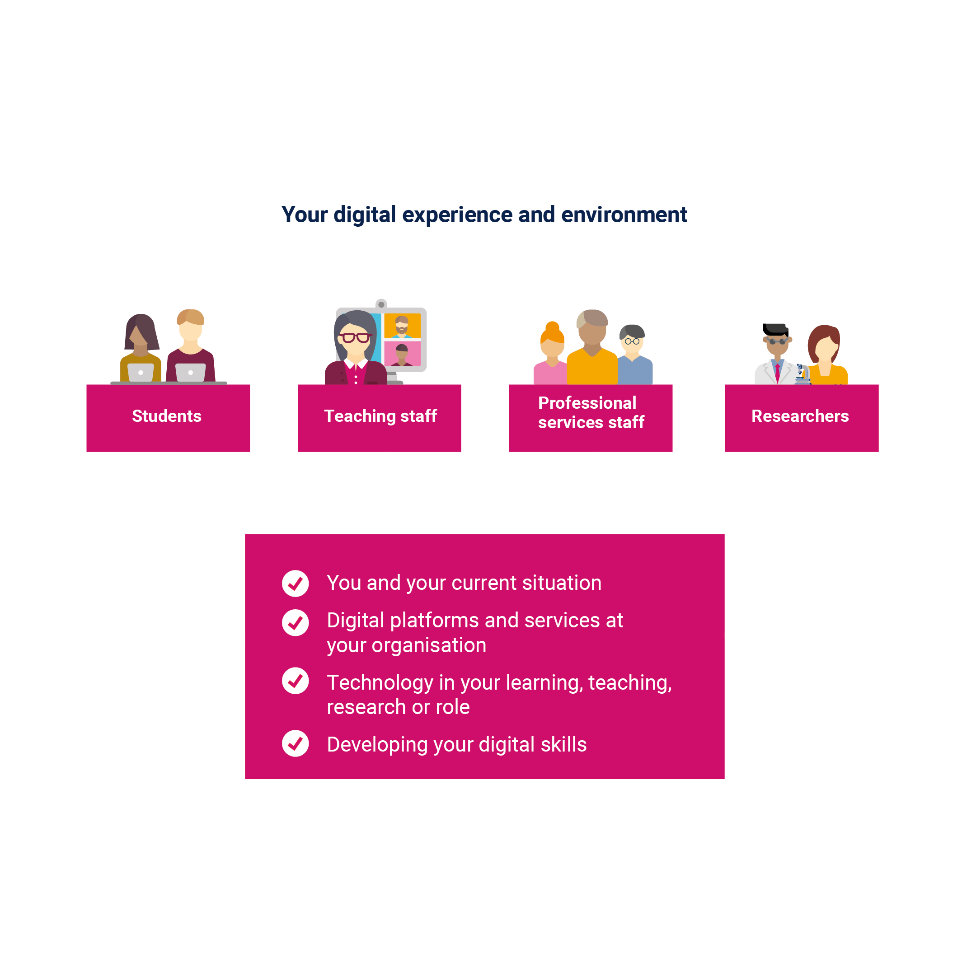
What is the researchers digital experience insights survey?
Asks researchers across higher education (HE) about their experiences of using technology at their university
Run by Jisc
For 2021/22 there were nearly 850 responses from UK researchers
This presentation summarises some key findings from data collected from our researchers

Slide 4
Summary of key metrics
Right click on chart and select: ‘edit data/edit data in Excel'
Technology at your organisation
XX% agreed they were supported to use their own devices (Q15a)
XX% agreed we supported them to access online platforms/services off campus (Q15b)
XX% agreed they were comfortable with how their data was collected and used (Q16b)
XX% rated the quality of the online environment for research as good or above (Q18)
Technology in your research
XX% agreed that the use of digital resources was convenient (Q24a)
XX% agreed that the use of digital resources enabled them to make good progress in their research (Q24c)
XX% agreed that the use of digital resources allowed them to assess students/learners fairly (Q24e)
Your digital skills
XX% agreed we provided them with formal recognition, accreditation or certification for their digital skills (Q28d)
XX% rated the support we offered them to work effectively online as good or above (Q31)

Slide 5
Benchmarking with other UK organisations

Slide 6
Benchmark comparisons
The digital experience insights surveys national dataset allows us to compare our results with anonymised overall results from other UK organisations that ran the researchers insights survey (see table below). Section 4 of our guide to using insights surveys in Jisc online surveys provides information on how to view, download, analyse and benchmark your data.
We have compared the nine key metrics shown earlier in this presentation on slide 4.
Add any insight or comments relevant to your data in comparison with the UK data.
Question | Our data | UK data
Supported to use own devices (Q15a) | XX% | XX%
Support access to online platforms/services off campus (Q15b) | XX% | XX%
Comfortable how their data collected and used (Q16b) | XX% | XX%
Quality of online environment for research (Q18) | XX% | XX%
Use of digital resources was convenient (Q24a) | XX% | XX%
Use of digital resources enabled them to make good progress in their research (Q24c) | XX% | XX%
Use of digital resources allowed them to assess students/learners fairly (Q24e) | XX% | XX%
Provided with formal recognition, accreditation or certification for digital skills (Q28d) | XX% | XX%
Support offered to work effectively online (Q31) | XX% | XX%

Slide 7
Findings by theme

Slide 8
Our researchers sample
We asked XXX researchers (XXX campus)
They were sent the link by (which marketing methods did you use to reach out to your researchers? Did you advertise one link to the survey, or did you email them unique links to the survey?)
XXX number of our researchers responded to the insights survey (% response rate)
The following slides summarise data from key questions in the four areas of the insights question set
Whenever researchers were asked how much they agreed with a statement they could answer either agree, neutral, or disagree

Slide 9
Theme one (T1)
You and your technology

Slide 10
Our survey sample
Percentage breakdown of researchers that responded to the survey versus all your researchers in your organisation, by gender (Q4).
Does the DEI survey look representative of your total researchers?
Where relevant, you can copy and paste the table above to create other breakdowns by ethnicity (Q6), number of years worked at organisation (Q1) and/or have an impairment/health condition or learning difference (Q7).
 | DEI survey | All researchers at our organisation
Female | XX% | XX%
Male | XX% | XX%
Prefer not to say | XX% | XX%
Prefer to self-describe | XX% | XX%

Slide 11
T1: Stage of researcher
Right click on chart and select: ‘edit data/edit data in Excel'
(Q2). Researchers were asked, which of these best described them (can only tick one):

Slide 12
T1: Devices used regularly for research work
Right click on chart and select: ‘edit data/edit data in Excel'
(Q8). Researchers were asked, which of these devices they regularly used for research work (they could tick all that applied).

Slide 13
Theme two (T2)
Technology at your organisation

Slide 14
T2: Digital platforms and services at your organisation
(Q15a). XX% agreed we supported them to use their own devices
(Q15b). XX% agreed we supported them to access online platforms and services off campus
(Q15c). XX% agreed we communicated effectively online, eg messaging, notifications

Slide 15
T2: How data is collected and used
(Q16a). XX% agreed they understood how the university collects and uses their data
(Q16b). XX% agreed they are comfortable with how their data is collected and used

Slide 16
T2: Digital tool or app really useful for research
(Q17). Researchers were asked to give an example of a digital tool or app they found really useful for research.
This was a free text question, which we analysed for themes.
Common themes included:
XX% of researchers that commented mentioned this…
XX% of researchers that commented mentioned this…
[Download your free text data via Jisc online surveys ‘analyse’ area, open in Word or Excel, read the feedback and try to group into themes (see accompanying Excel sheet to carry out grouping here). Also, the guide to analysing your qualitative data can be found here.]

Slide 17
T2: Overall quality of the online environment for research
Right click on chart and select: ‘edit data/edit data in Excel'
(Q18). Researchers were asked to provide an overall rating for the quality of the online environment for research. XX% rated us as good or above.
[Add any insights from the data here]

Slide 18
T2: Prefer us to invest in
Right click on chart and select: ‘edit data/edit data in Excel'
(Q19). Researchers were asked what they would prefer us to invest in if funds were available?
[Add any insights from the data here]

Slide 19
Theme three (T3)
Technology in your research

Slide 20
T3: Where your research took place and where prefer to research
Right click on chart and select: ‘edit data/edit data in Excel'
(Q21). Researchers were asked, in the current academic year, where their research took place and where they prefer to research
[Add any insights from the data here]

Slide 21
T3: Difficulties using digital technologies
Right click on chart and select: ‘edit data/edit data in Excel'
(Q22). Researchers were asked if any of these made it difficult for them to use digital technologies in their research (they could tick all that applied).

Slide 22
T3: Research activities they have carried out
Right click on chart and select: ‘edit data/edit data in Excel'
(Q23) Researchers were asked, in the last academic year, which of these activities had they engaged in as part of their research
[Add any insights from your data here]

Slide 23
T3: Use of digital technologies in their research
Right click on chart and select: ‘edit data/edit data in Excel'
(Q24). Researchers were asked how much they agreed with five statements about the use of digital technologies in their research:
[Add any insights from your data here]

Slide 24
T3: Positive aspects of researching using digital technologies
(Q25). Researchers were asked, what aspect of researching using digital technologies, if any, was most positive for them?
This was a free text question, which we analysed for themes.
Common themes included:
XX% of researchers that commented mentioned this..
XX% of researchers that commented mentioned this…
[Download your free text data via Jisc online surveys ‘analyse’ area, open in Word or Excel, read the feedback and try to group into themes (see accompanying Excel sheet to carry out grouping here). Also, the guide to analysing your qualitative data can be found here.]

Slide 25
T3: Negative aspects of researching using digital technologies
(Q26). Researchers were asked, what aspect of researching using digital technologies, if any, was most negative for them?
This was a free text question, which we analysed for themes.
Common themes included:
XX% of researchers that commented mentioned this..
XX% of researchers that commented mentioned this…
[Download your free text data via Jisc online surveys ‘analyse’ area, open in Word or Excel, read the feedback and try to group into themes (see accompanying Excel sheet to carry out grouping here). Also, the guide to analysing your qualitative data can be found here.]

Slide 26
T3: Chance to be involved in decisions
Right click on chart and select: ‘edit data/edit data in Excel'
(Q27). Researchers were asked how much they agreed they were given the chance to be involved in decisions about their digital experience
[Add any insights from the data here]

Slide 27
Theme four (T4)
Your digital skills

Slide 28
T4: Support and guidance for digital skills development
Right click on chart and select: ‘edit data/edit data in Excel'
(Q28). Researchers were asked five questions about the support and guidance they receive for digital skills development.
[Add any insights from the data here]

Slide 29
T4: Where did researchers go for help with online and digital skills?
Right click on chart and select: ‘edit data/edit data in Excel'
(Q29)
[Add any insights from the data here]

Slide 30
T4: Which skills had we provided support or training for?
Right click on chart and select: ‘edit data/edit data in Excel'
(Q30).
[Add any insights from the data here]

Slide 31
T4: Support to help researchers work effectively online
Right click on chart and select: ‘edit data/edit data in Excel'
(Q31). Researchers were asked to provide a rating for how well they feel we supported them to work effectively online: XX% rated us as good or above.
Add any comments based on findings from your data

Slide 32
T4: Help to use digital technologies effectively
(Q32). To help you to use digital technologies effectively, what one thing should we do?
This was a free text question, which we analysed for themes
Common themes included:
XX% of researchers that commented mentioned this...
XX% of researchers that commented mentioned this…
[Download your free text data via Jisc online surveys ‘analyse’ area, open in Word or Excel, read the feedback and try to group into themes (see accompanying Excel sheet to carry out grouping here). Also, the guide to analysing your qualitative data can be found here.]

Slide 33
What next?
Some further things to consider include:
Do you have any insights survey data from other surveys to compare with the researcher's data?
Who will you communicate these findings to?
How will you feed back results to learners, students and staff that support researcher engagement across your organisation?
How do you plan to work in partnership with researchers to take forward actions resulting from the data?

Slide 34
Suggested next steps…
[Add any recommendations for your organisation]

